Slide 1
MIS636
Data Warehousing and Business Intelligence
Introduction to Business Intelligence
Decision Support Systems
Building an Analytical Capability
Source: Kimball, Davenport, Morabito, Stohr, etc.
© J. Morabito, 2012

Slide 2
Decision Support Systems
© J. Morabito, 2012

Slide 3
Decision Support Systems
DSS: Systems that support decision making in “unstructured” situations where it is not possible, or not desirable, to have an automated system perform the entire process.
Often developed outside of the IS department (by “end users”).
Many spreadsheet models are DSS - they use sensitivity analysis to help users make decisions.
Unstructured problem: A problem is unstructured to the extent that:
(1) cause effect relationships are unknown
(2) there is uncertainty rather than risk
(3) variables are not measurable in any physical sense
(4) there are multiple, conflicting goals
© J. Morabito, 2012
Notes:
DSS that support decision making in unstructured situations where not possible to automate system perform entire process
Uncertainity, variables are not measurable and multiple conflicting goals

Slide 4
Evolution of Decision Support
Information Continuum
Management
Reporting
Adhoc
Queries
Analytical
Applications
K
Discovery
What? How? Why?
Transaction
Processing
Management
Reporting
Data
Visualization
Data
Mining
OLAP
OLTP design
Transaction & operational
Key: Consistency of update
OLAP design
Decision support
Key: Speed of retrieval
Value-added data,
Visualization
ODS design
Operational query
Key: Operational data integration
OLTP
Reporting
Instances
© J. Morabito, 2012

Slide 5
Variety of Query Types
Query Type
Transaction
Query
Operational
Query
Data Warehouse
Query
OLAP
Query
Data Mining
Query
operational
support
analysis & decision
support
Transaction: Locate the address of a client
Operational: Uncover the audit trail of a lost item (trade, merchandise)
DW: Find the trend in sales of a particular product in a specific region
OLAP: Find the sales of all products by month and region
DM: What products have similar sales patterns
DM: Find the rules that predict the sale of a certain product to a certain customer segment
OLTP
OLAP
Data
Mining
What are the distinguishing characteristics of each query type?
© J. Morabito, 2012

Slide 6
Business Intelligence and Analytics
Adapted from Davenport … Adapted from SAS
Optimization
Predictive modeling
Forecasting/extrapolation
Statistical Analysis
Alerts
Query/drill down
Ad hoc reports
Standard reports
What’s the best that can happen?
What will happen next?
What if these trends continue?
Why is this happening?
What actions are needed?
Where exactly is the problem?
How many, how often, where?
What happened?
Analytics
Competitive Advantage
Data access
and
reporting
Degree of Intelligence
BI = Data Access + Reporting + Analytics
© J. Morabito, 2012

Slide 7
Analytical Technologies
Davenport (adapted from)
Pencil and paper
Spreadsheets
Online analytical processors (OLAP)
Statistical or quantitative algorithms
Rules engines
Data mining tools
Text mining tools
Simulation tolls
Text categorization
Genetic algorithms
Expert systems
Audio and video mining
Swarm intelligence
Information extraction
Typical
Analytical
Technologies
Emerging
Analytical
Technologies
© J. Morabito, 2012

Slide 8
Competing on Org Processes
Adapted from Davenport
INTERNAL PROCESSES
Financial
Manufacturing
R&D (Product Dev)
HR
EXTERNAL PROCESSES
Customer
Supplier
Can we improve this list?
E.g., Product … this is not a process but a business perspective
E.g., the development of the CMA product at Merrill by noticing the association between “my bank” and checking accounts (this is an example of innovation)
© J. Morabito, 2012

Slide 9
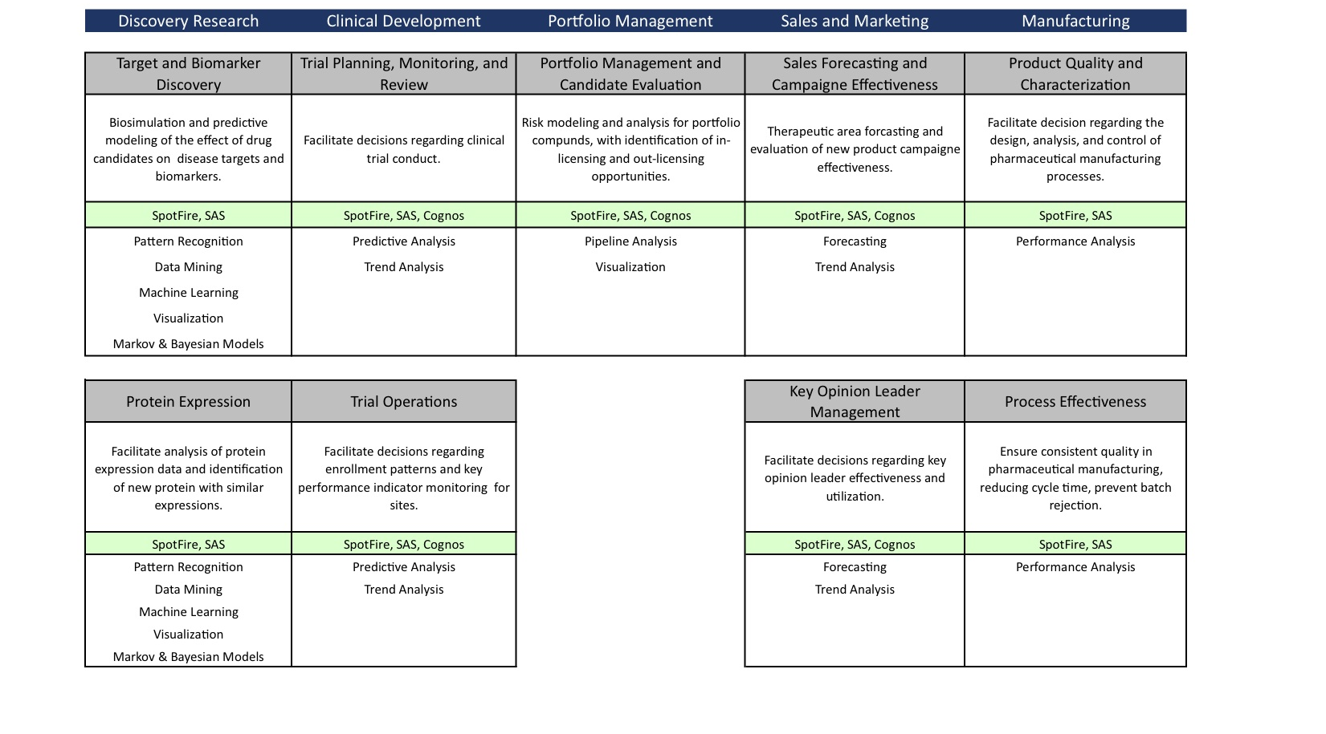
Competing on Internal Processes
Example: Life Sciences (Partial)
© J. Morabito, 2012

Slide 10
Informating Capability
Foundational to Becoming an Analytical Competitor
Business Processes
Static
Real-time (e.g., data mining & flight control)
Informating Capability
Reporting
Analysis
Real-Time
Reports
(data)
Historical
Reports
(data)
Online
Analytical
Processing
Data Mining
Specialized
Applications
Knowledge-Intense Processes
See Continental Airlines case study
© J. Morabito, 2012

Slide 11
An Example from Marketing
Geoffrey Moore
Real-time Cross Selling
Loyalty Programs
Database Marketing
Mass Customization
Niche Marketing
Mass Marketing
Investor demand for more growth despite saturated markets
Real-time prompts to customer during transaction
Intelligent, interactive order-entry; self-service
Saturated markets create competition for existing customers
Special offers to retain most valued customers
Loyalty programs based on customer history
Saturated markets cause shift in focus to existing customers
Installed base marketing
Direct (e)mail focused on individual customer profile
Market saturation & commoditization of pricing
Expand market boundaries; maintain margins
Customizable offers promoted as enhanced cust. experience
Market penetration
Customer-centric marketing (pull)
Solution-based programs focused on customer buying pattern
Hyper-growth markets
Product-centric marketing (push)
Product launch programs focused on distribution and pricing
© J. Morabito, 2012

Slide 12
An Example from Marketing 2
Geoffrey Moore
Real-time Cross Selling
Loyalty Programs
Database Marketing
Mass Customization
Niche Marketing
Mass Marketing
Data mining results for inventory clustering, individual customer history, post-DW model …. Expert systems
Integrate with order-entry system
Customer transaction history, cost accounting by transaction
Enterprise-wide DW; Data mining
Integrate with CRM system
DW: Detailed order history, customer contact information
OLAP and analytical applications
Integrate with customer service system
Marketing datamart: demographics, geocoded sales data
OLAP
Integrate with downstream supply chain system
Customer-domain and competitor
Knowledge management (unstructured), text retrieval systems
Integrate with sales force automation system
Inventory, sales results, cost of goods
Enterprise reporting, adhoc query and analysis tools
Integrate with inventory and upstream supply chain systems
© J. Morabito, 2012

Slide 13
Building an Analytical Capability
Becoming an Analytical Competitor
© J. Morabito, 2012

Slide 14
Why Compete on Analytics?
An organization’s data is the last remaining source of advantage … i.e., creating value for the org
Organization’s can compete on the basis of internal and external processes
In one sense, the data is there … its sitting in your systems waiting to be exploited for value
On the other hand, “big data” refers to “datasets whose size is beyond the ability of typical database software tools to capture, store, manage, and analyze” (McKinsey)
In either case, the opportunities are being exploited by every organization’s competitors.
Fact-based science
Fact-based decision making
© J. Morabito, 2012

Slide 15
Key Elements in an Analytical Capability
Organization
Human
Technology
Insight into performance drivers
Choosing a distinctive capability
Performance management & strategy execution
Process redesign & integration
Leadership & senior executive commitment
Establishing a fact-based culture
Securing and building skills
Managing analytical people
Quality data
Analytical technologies
© J. Morabito, 2012

Slide 16
Developing In-House Expertise
Enterprise Perspective
Analytical
Disciplines
Tools &
Org
Factors
Data
Disciplines
Business
Applications
Knowledge
© J. Morabito, 2012

Slide 17
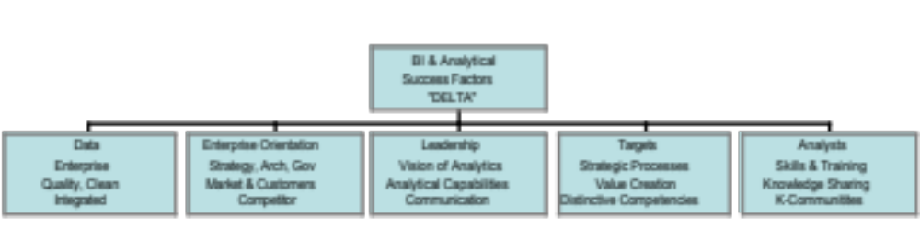
Competing on Analytics
Davenport
Stage 5
Analytical Competitors
Stage 4
Analytical Companies
Stage 3
Analytical Aspirations
A clear shift from
localized efforts to
enterprise analytics &
org/systems integration
Stage 2
Localized Analytics
Stage 1
Analytically Impaired
© J. Morabito, 2012

Slide 18
Roadmap to Analytical Competitor
Stage 1
Analytically
impaired
Localized
analytics
An organization has some data and management interest in analytics
Management
Support:
prove-it
path
Functional management builds analytics momentum and executives’ interest through application of basic analytics
Stage
2
Top
management
support
Stage 3
Analytical
aspirations
Executives commit to analytics by aligning resources and setting a timetable to build a broad analytical capability
Terminal stage: some companies’ analytics efforts never receive management support and stall here as a result
Stage 4
Analytical
companies
Enterprise-wide analytics capability under development; top executives view analytic capability as a corporate priority
Another possibility is that organizations never leave Stage 2.
They remain function or department centered and do not leverage the benefits of an enterprise approach
Stage 5
Analytical
competitors
Organization routinely reaping benefits of its enterprise-wide analytics capability and focusing on continuous analytical renewal
© J. Morabito, 2012

Slide 19
DELTA Example: Choosing a Strategic Focus
Harrah’s: loyalty plus service
NE Patriots: player selection plus fan experience
Dreyfus Corp: equity analysis plus asset attrition
UPS: operations plus customer data
Wal-Mart: supply chain plus marketing
Owens & Minor: internal logistics plus customer cost reduction
Progressive: pricing plus new analytical service offerings
YOUR COMPANY: ????
Managing the bottom line
vs. (or do both)
Building the top line
© J. Morabito, 2012

Slide 20
BI Architecture (Davenport)
Transformation tools
and processes
Analytical tools
and applications
Data management
Repositories
Presentation tools
and applications
Metadata
Operational processes
© J. Morabito, 2012

Slide 21
Organizational-BI Architecture
Transformation tools
and processes
Analytical tools
and applications
Data management
Repositories
(Data Presentation)
Presentation tools
and applications
Data-Driven
Strategic Plans & Targets
Organizational & Management
Actions and Policies
Metadata
Operational processes
Business Knowledge and Drivers
© J. Morabito, 2012

Slide 22

Subject Architecture Full Scale
MANAGEMENT & MONITORING
External 1
OLAP
oper 2
USER
Access
Extract
Record
Integrate
Rationalize
Transform
Derive
Summarize
Datamart:
Cube (6)
Data Staging:
Data
transform
& cleansing
ERP 3
Data Mining (7)
USER
oper 4
Atomic
DW:
REAL-TIME (1)
OP-Mart (2)
ODS (3)
STAR (4)
AGGREGATIONS (5)
data query
& reporting
Web logs
USER
operational &
external data
access to other forms of data & documentation
Supporting meta-data (8): business models, events & rules, library of reports & queries, data dictionary, data transformation, derivation, and summarization rules, data source & ownership, refresh schedule
© J. Morabito, 2012

